Slide 1
MCLI Dialogue Day: Reaching and Teaching Student Veterans for Classroom Success
Miguel Fernandez, Faculty Liaison for Student Veterans Composition, Literature, Creative Writing Faculty
Presentation & Entire Toolkit for developing veteran friendly faculty training: http://miguelfernandez.com/?p=65
Nov 13 2015

Slide 2
AGENDA (2.5 hrs)
1:40pm-2pm THE most impt thing you can do for your classroom: Sample SYLLABUS section for Military Connected: win (faculty)-win(students)-win(admin & support)
2pm-2:20pm
Background on Veterans: Stereotypes, Myths or Realities?
Practical tips: Rounds 1, 2, 3
2:20pm-2:30pm BREAK (2:30 A. Olivas)

Slide 3
AGENDA (2.5 hrs)
2:40pm-3:15pm Role of Veteran Services & A Student Veteran Biggest wish, biggest problem, thing they wish others knew
Walk-through: Scenario: triggered incident 3pm Q&A
3:15-3:25: Active Learning: 3 scenarios: Groups for 10 min 3:25: GROUP Discuss scenarios of 3: for solutions 3:50 CLOSE UP: Evals, Assessement (Reflections)

Slide 4
For Faculty Professional Growth
Fill out Sign up Sheet
Complete and hand in Evaluation form
Complete assessment/reflection form
Complete the application for Faculty Prof. Growth Non-Academic Clock hours avail online within 90 days and turn in the paper copy to your FPG representative. internal_app.doc https://mcli.maricopa.edu/files/fpg/internal_app.doc [46k]
I will complete attendance Verif form

Slide 5
Introductions
Name,
job/title,
College/affiliation
What you hope to get from this session

Slide 6
Overview: What caught your attention?
How many people, have had interactions with veteran students, co-workers, employees, etc that brought to attention the ‘vet’ part?
Positive? (leadership, drive, direct action)?
Negative? (confrontations, conflict, off norm reactions, anger issues?)

Slide 7
Why Military connected students can be challenges in the classroom
Priority of education vs life demands
Cynicism towards academics and civilians
Out of school for some time → treated as developmental
Accommodations (NOT exceptions!)
Cannot relate to younger students
Want Structure!
“Bad habits” issues of authority, especially with female instructors

Slide 8
Why Military connected students can be assets in the classroom
Inclusion
Diversity
Experience
Leadership
Follow through
Values become ‘mission’

Slide 9
Hey it was Veteran’s Day!
YES/NO: Ask Vets to stand up and say: Thank you for your Service? The what’s next

Slide 10
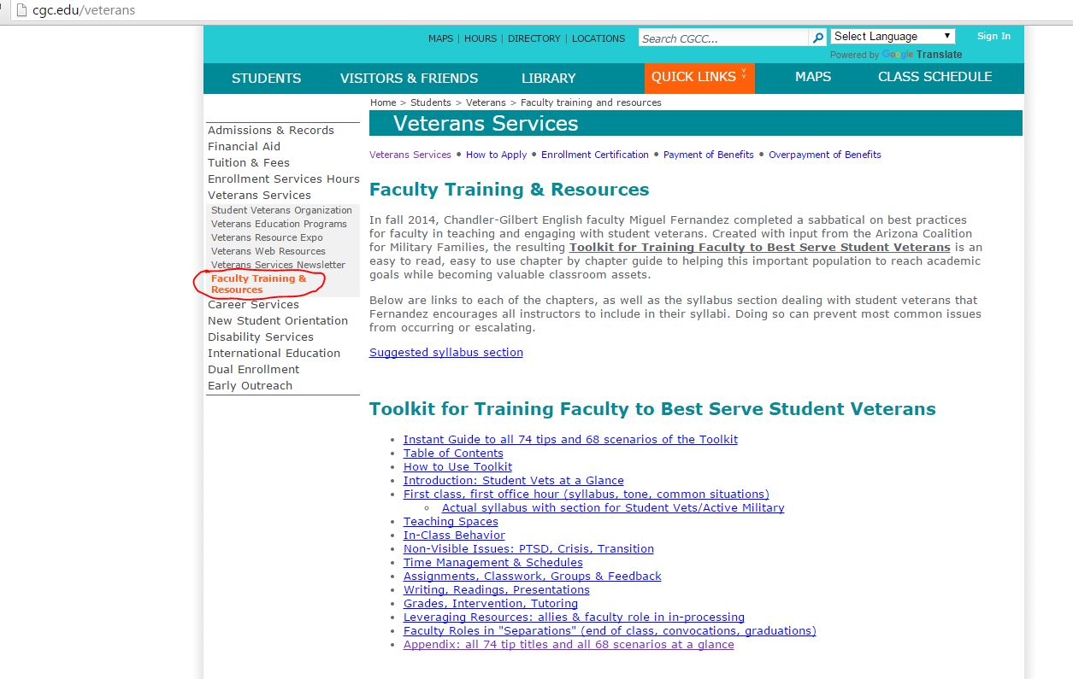
A section on your Syllabus for Military-connected Students
http://cgc.edu/veterans and click on ‘Faculty Training & Resources’

Slide 11
Syllabus Section HEADER
Student Veteran/Reserves/Guard/Active Duty: Support & Responsibilities: ‘Student veterans are DEFINED as any branch/level of prior, active or current military service – active, retired, reserves, guard, combat, support, logistics, with/without GI Bill, attending college as a student’. Student Veterans have access to ALL standard college student services (tutoring, computer lab, clubs,etc) plus specific veteran support and transition resources.

Slide 12
Syllabus Section A:
A)The college operates for all students under the mission of ‘accommodation, not exceptions’ when it comes to course content and grading, college requirements and expectations, and the ‘contract’ of the course syllabus. That said, there are massive assets and support available for all stages and needs of student vets transitioning to college.

Slide 13
Syllabus Section: B
B)Student veterans are ‘strongly suggested’ to self-identify to the instructor on or before day 1 [“I want my vet students to get a fair shake, so…”] “(privately is fine), especially if seeking awareness for or needing accommodations including but not limited to scheduling (VA appointments, unit activation/deployments possible mid-semester), course content (PTSD trigger risk topics or activities, for example), physical or other service-related needs(service animal, visual or hearing impaired assistance/ technologies, PTSD, in-treatment status, seating location needs, etc). Some accommodations require confirmation, such as registering with DRS (Disability Resources Services). Contact Office of Student Veteran Services for further information on any questions related to accommodation needs. Reasons for excusable absences for student veterans must be presented as early as possible and may be considered only for previously self-identified veterans”

Slide 14
Syllabus Section C:
C) Accommodations: Excused Absences for student veterans, reservists and activated military connected:
“As documented in the student handbook and college rules, reasons for excusable absences for student veterans must be presented as early as possible (VA appointments, medical procedures (eg surgery) including pre and post recovery periods, activations, reservist training).”

Slide 15
Syllabus Section D:
D) #1 Student Veteran issue: VA Policy if you Stop Attending Class: F vs DROP: ‘Students who simply stop attending classes will be dropped, with possible consequences related to VA policies and payments’ (can range from VA /GI Bill requiring student to repay the course out of pocket, lowered and/or pro-rated living allowance, change in full time student status which may affect benefits). If you need to stop attending a class, contact the instructor as soon as possible, give a reason, check your options with instructor and Office of Student Veteran Services.”

Slide 16
Syllabus Section E:
“E) Primary Rallypoint/Student Veteran starter Contact: Office of Student Veteran Services 480,726.4122, Coyote Center 2nd floor (Services Coordinator: Reda Chambers, tel:480-726-4094, reda.chambers@cgc.edu ). Start here for ‘what do I do next at the college’ questions, Green Zone contacts on campus, referral points, G.I. Bill and Also: student veteran’s lounge
Pecos Campus Lounge: Coyote Center, 2nd Floor. Tel: 480,726.4122. Open 8am – 5pm Williams Campus Lounge: Bluford Hall, Tel: 480.988.8177. 7360 E. Tahoe Avenue Mesa, AZ 85212.
What is the magic triangle of support for student vets? Veteran Student Services + (Faculty + Advising ally) + SVO/SVA

Slide 17
REMINDER: cut & paste from:
http://cgc.edu/veterans and click on ‘Faculty Training & Resources’ & discuss w/dept chair

Slide 18
Random Round #1 of TIPS
The 3 poses
Golden rule: If you know one Vet, you know one Vet
Many resent slackers or people given exceptions. They value fair and by the rules, with frameworks of responsibilities and consequences.

Slide 19
Background on Veterans
1)WHAT THEY CARRIED: All veterans carry the burden of combat
experience (visible and non-visible issues): YES & NO
Issues veterans bring back VARY based on where deployed, their MOS, their status (combat, support, logistics)1, and their background. There are veterans who may have worked with accounting reports 24/7 and those who were in direct line of fire much of the time. It’s okay to ask a veteran their branch, time of service: however, it’s not polite to ask their MOS or what they did. Many will volunteer this.
Some will not. Regardless of duties, never ask about killing. There may be
criticism or joking between different positions served but a ‘cook’ or person serving a ‘desk job’ at a FOB (Forward Operating Base) may hear derision or judgment from students (or even other instuctors) who consider the former lesser service than combat action.

Slide 20
Background on Veterans
1)WHAT THEY CARRIED: experience (visible and non-visible issues) and/or Guilt or Loss of order PTSD
Chronic hyper-vigilance
• Recurring flashbacks
• Frequent nightmares
• Persistent insomnia
• Emotional numbness
• Difficulty concentrating
• Outbursts of anger
“PTSD feels like a haunting. You can’t negotiate with yourself that it’s not rational… It takes control. Most important thing is that it’s not forever. Feels like it Feels like a hostile divorce. But it can be adapted and dealt with and controlled.”2 --2 Margaret Bellafiore. “From Combat to Campus”. Academe (Journal of American Association of University Professors). Volume 98, Number 5 . September-October 2012

Slide 21
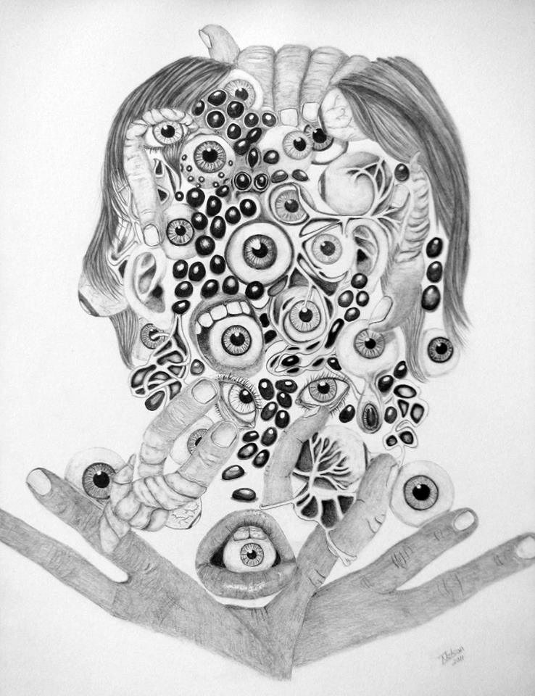
Hypervigilance

Slide 22
Background on Veterans
In conversation & referral to help: Post Traumatic STRENGTH
Solution Buzzword: Resilience -- ability to become strong, healthy and successful in spite of stressors, Post Traumatic Strength: You come out on the other side of something awful
Transition: is a way to address, label, goals of dealing with PTSD even w/those who don’t want to self identify as PTSD.
For an excellent source of all types of information and resources on PTSD for active, reserve, guard and veterans, highly recommend: http://www.realwarriors.net/active/treatment/ptsdmyths.php

Slide 23
Random Round #2 of TIPS
Vet students often maintain a façade of adjustment until blow up
Approaching a sleeping vet/Vet in hunker down mode (hat, headphones)
Family deploys/deployed

Slide 24
Background on Veterans
2) Veterans bonding vs isolation from non-veterans
Vets are sometimes very skeptical or cautious about connecting with ‘general population’: from political beliefs, from a feeling that civilians just can’t related, from a sense and judgment that younger / main population are immature or have NO IDEA about what really matters in life.
Properly transitioned, military connected employees adapt to their roles as students in the general population. This is part of the goal with diversity awareness for veterans: integration and transition to civilian mainstream roles. That said, Green zones can help this transition happen when frustration, interpersonal conflict, and ‘not fitting in’ hit a boiling point)

Slide 25
Background on Veterans
2) Veterans bonding vs isolation from non-veterans
Some veterans want to leave their military experience behind, while others live to share war stories and bond the way they did in the military. For some, the military represents everything that was righteous and family; others have lots more in common with civilian subcultures (for example, in personal experience, one mixed group of traditional/veteran students bonded thoroughly, based on shared opinions of Anime).

Slide 26
Background on Veterans
3)Veterans are ready to take over and lead groups and teams
In service, there’s always a ‘team leader’ or squad leader or NCO or inspection that makes sure service members are on the ball, on the job, and not neglectful of any step or duty required of them for their unit and/or mission. Some veteran students will rise up to this role – especially if they actually led (squad or rank or duties/MOS) or had leadership training.
Some will not. Some can lose self sufficiency outside of the familiar regimented structure of the military. Main take-away: those who had leadership roles, may be excellent leaders and organizers for group and collaboration work. Others will play their part. Others will resent leading especially if they see it as a result of self-identifying as a veteran. Mileage may vary. Hope, but don’t presume, that student veterans can and will successfully lead, manage, student groups

Slide 27
Background on Veterans
4)IT’s NOT PTSD: IT’s Transition to a new mission – change in social status
Transition to a new mission – change in social status
A source of conflict and frustration comes from change in location, move, or family living situation reorganization:
“The geographic mobility that the military expects of active-duty families can be a source of both stress and excitement. Active-duty military personnel must move on average once every two to three years, meaning that military families move 2.4 times as often as civilian families.” (AZ Coalition for Military Families). New living quarters, new state application for schools, out of state status for dependents’ tuition and benefits, licenses, arrangements for child support, etc – Not PTSD. Definitely frustration that may manifest as exhaustion or anger as veterans transition to career/work.
The Arizona Coalition for Military Families is a public/private partnership focused on building Arizona's statewide capacity to care for and support all service members, veterans, their families and communities.

Slide 28
Background on Veterans
4)IT’s NOT PTSD: IT’s Transition to a new mission – change in social status
Change in social status and structure/routine disruptions becomes frustration as a transition byproduct: Transition leading to social status reset, after so much time physically and socially apart, can be the root of many problems in the workplace, including fitting in, concentrating, taking job/customer service as high priority: “Vet return to entry level as civilian after achievement in the service…”
WHY?
A)Injured don’t get to separate and say good bye to their battle buddies and military families.
B)…Family was functional without vet: suddenly vet is back home and his ways have to change to ‘fit’ in as ‘roomie’ for family… don’t know their place in family 2.0”7 Once returned, family always represent a commitment that comes first: kids, sickness, dependents, fights, satellite roles and interplay between everyone’s roles and personalities.

Slide 29
Practical Round #3 of TIPS
Easy fixes for student vet success: Checklists! sample topics, example HW from previous semester or walk through on youtube **
Not just ‘support services’: add ‘how to’
no career ‘major’ exploration: whatever major was ‘marketed’ to them in the general field (what’s diff between computer science and IT certificate or major?) is what they may declare and start courses towards. Many veterans are especially out of the loop because they were not attending career days and similar ‘high school to college’ orienteering activities.

Slide 30
Background on Veterans
6) If they don’t buy into value of college….Cheating, honor codes, Plagiarism
Desperation/”The Patriot Card”: Occasionally as faculty you’ll have a student veteran ask for exception and privilege – they served, their schedule was disrupted because of government duty, can they have a break “after putting their heads on the line in service to the country who’s academic freedoms we all enjoy”. Not common, but not rare. Can irritate the life out of other student veterans who see this happen. Here is where accommodation, not exception, makes all the difference.
You should accommodate (not Exceptions) situations that happen regarding scheduling, VA appointments, deployments (by law/handbook!), PTSD or medical incidents (changes of medication, triggers, etc), anniversaries and intense or sudden events requiring their leave or absence or
For consideration: A deadline re-negotiation request (for example, pending unit activation during exam week or the call about a casualty of a still active member during a ‘no phones on’ class).
Your syllabus IS CONTRACT: should cover the expectations for accommodation.

Slide 31
10 min Break
After break: 1)A. Olivas 2) Q&A and vitals viewpoint from: Veteran Services Student Veteran
3)No more lecturing! Group work! 3 Scenarios

Slide 32
Intros & Role of Veteran Services & A Student Veteran Biggest wish, biggest problem, thing they wish others knew
Walk-through: Scenario: triggered incident 3pm Q&A

Slide 33
SCENARIO: A phone ringtone sounds that samples a gun and veteran goes under the table and pulls down a student next to him/her, as well, to ‘safety’ . Veteran student freezes and other students are looking on strangely and veteran emerges embarrassed. You are instructor, in vicinity of incident. What do you do?. 1)What’s going on? What are the issues? Risks? 2)What should you do? 3)Suggestion and why? (write group ideas on back)

Slide 34
GROUP ACTIVITY: Groups
3 SCENARIOS
Take 10 min for sheet
We’ll group share

Slide 35
SCENARIO : A fellow female instructor complains that a veteran student is undermining her authority and using sexist and non-workplace appropriate language with other students. 1)What’s going on? What are the issues? Risks? 2)What should you do? 3)Suggestion and why? (write group ideas on back)

Slide 36
SCENARIO : A student or fellow employee says they are worried about a student veteran being at risk for suicide. They have a ‘feeling’ but don’t have any evidence. What do you do. 1)What’s going on? What are the issues? Risks? 2)What should you do? 3)Suggestion and why? (write group ideas on back)

Slide 37
SCENARIO: Veteran student is ‘inappropriately’ participating in class. Language or ‘directness’ is upsetting the classroom of mostly younger students. You discuss with student veteran and they apologize. Now they are either NOT participating at all, or after a few days, excited in conversation and then back to ‘inappropriately’ taking control of conversations, over-expressing self. What do you do? 1)What’s going on? What are the issues? Risks? 2)What should you do? 3)Suggestion and why? (write group ideas on back)

Slide 38
SCENARIO: Veteran student spots a student in class wearing a shirt that says, “Stomp the Flag to Protest American Fascism” and an upcoming date. He calls out the student on the shirt and the discussion is slowly escalating. What do you do? 1)What’s going on? What are the issues? Risks? 2)What should you do? 3)Suggestion and why? (write group ideas on back)

Slide 39
SCENARIO : After a group activity, a veteran student leaves class in a bit of a huff. Everyone is quiet but there appears to have almost been a fight when someone had said the vet was not really a soldier – they were a ‘fobbit’ and sat at a computer and didn’t see combat. 1)What’s going on? What are the issues? Risks? 2)What should you do? 3)Suggestion and why? (write group ideas on back)

Slide 40
SCENARIO : A veteran student says they were coming to class today when they suddenly froze on the road, in their car, feeling they were on a highway in Iraq and threats all around them. It only lasted for 10 minutes but wanted you to know it’s why they were late. 1)What’s going on? What are the issues? Risks? 2)What should you do? 3)Suggestion and why? (write group ideas on back)

Slide 41
SCENARIO : Student Veteran has stopped submitting work and showing in class for two weeks. They have been dropped with a W. The student asks if you can change the grade to a F – they say the W means they will be billed for the class instead of being covered by their GI Bill benefits. 1)What’s going on? What are the issues? Risks? 2)What should you do? 3)Suggestion and why? (write group ideas on back)

Slide 42
SCENARIO : A student says they don’t feel safe around a veteran student, because there has been some recent cases of vets going off and shooting up someone, and this vet student doesn’t socialize with others, and he tells dark jokes about death, etc. What do you do?. 1)What’s going on? What are the issues? Risks? 2)What should you do? 3)Suggestion and why? (write group ideas on back)

Slide 43
For Faculty Professional Growth
Fill out Sign up Sheet
Complete and hand in Evaluation form
Complete assessment/reflection form
Complete the application for Faculty Prof. Growth Non-Academic Clock hours avail online within 90 days and turn in the paper copy to your FPG representative. internal_app.doc https://mcli.maricopa.edu/files/fpg/internal_app.doc [46k]
I will complete attendance Verif form

Slide 44
Questions?
Miguel.fernandez@cgc.edu
www.miguelfernandez.com
Entire Toolkit for developing veteran friendly faculty training: http://miguelfernandez.com/?p=65

Slide 45
Extras: Background on Veterans
4)Transition to a new mission – change in social status
C)Programs for reintegration exist, but ‘one size rarely fits any’ in the complex dynamics of transition – especially with the veteran in the haze of new hire status:
“Yellow Ribbon programs”: before arrival of veteran, debrief family of changes to come for family reintegration…
TAPS: transition assistance programs are often limited or disregarded.”8 An example of a TAP to help transitioning service members, including Guard and Reserve members demobilizing after 180 days or more of active service, adjust to life after the military: ”GPS… http://www.benefits.va.gov/tap/...
an example of standalone GPS training online class on higher education or entrepreneurship:
http://jko.jten.mil/courses/tap/TGPS%20Standalone%20Training/start.html
D)Green Zone training/Green Zone spaces at work/colleges

